Slide 1
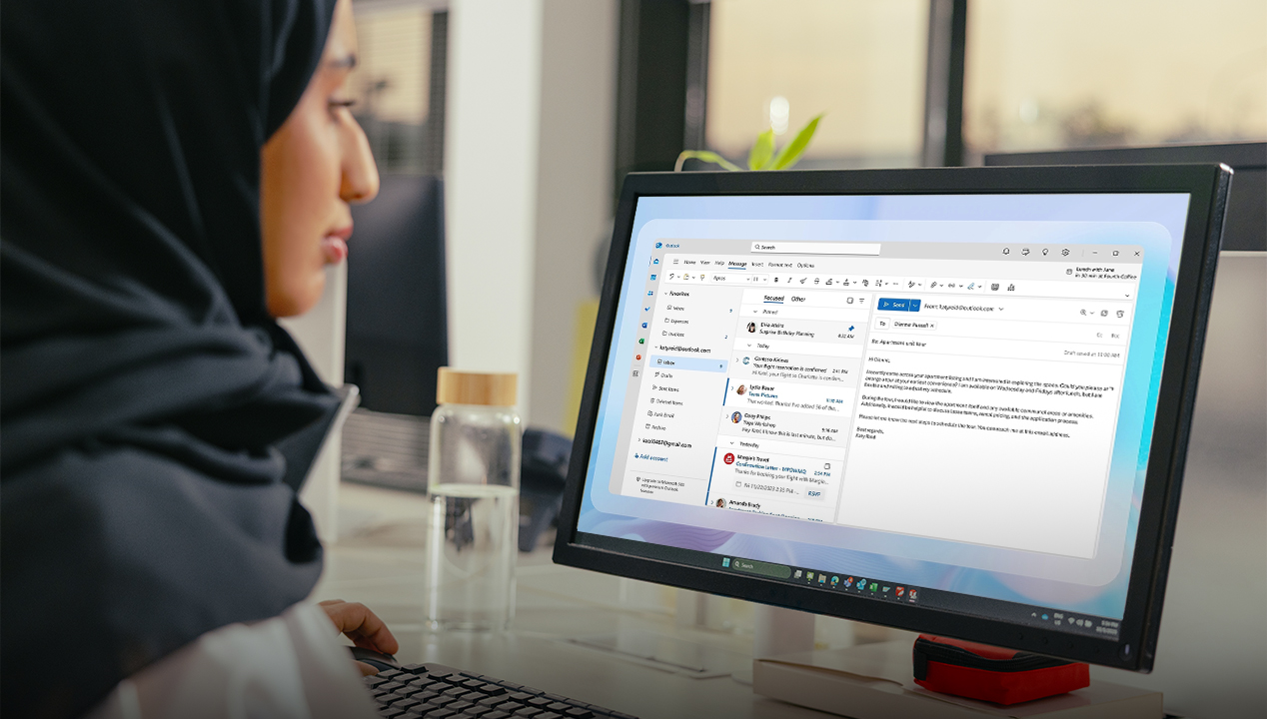

Email Signature
HOW TO SET IT UP
omancables.com

Slide 2
Using Outlook
omancables.com

Slide 3
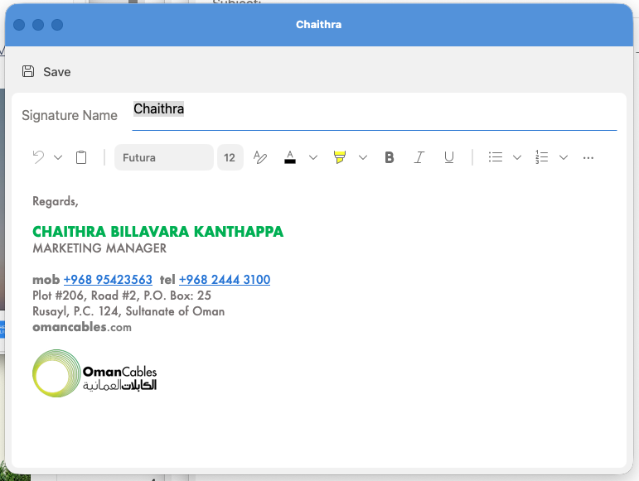

Email Signature Template
Email Signature:
Kindly use the template shown as the definitive model for all future email signatures.
Font Style:
Futura
Font Colors & Sizes:
Green, 12
Full Name
Job Description
M.+968 1234 5678, T.+968 1234 5678
Black, 11
Black, 11
Uploaded image
Medium Grey, 8
Confidentiality Notice: This email and any attachments are intended solely for the addressee and may contain privileged information belonging to Oman Cables Industry (SAOG). Unauthorized disclosure, forwarding, or use is strictly prohibited.
omancables.com

Slide 4

New Email Signature Template
Email Signature:
You may copy the text in the sample:
Full Name
Job Description
M.+968 1234 5678, T.+968 1234 5678
Confidentiality Notice: This email and any attachments are intended solely for the addressee and may contain privileged information belonging to Oman Cables Industry (SAOG). Unauthorized disclosure, forwarding, or use is strictly prohibited.
omancables.com

Slide 5
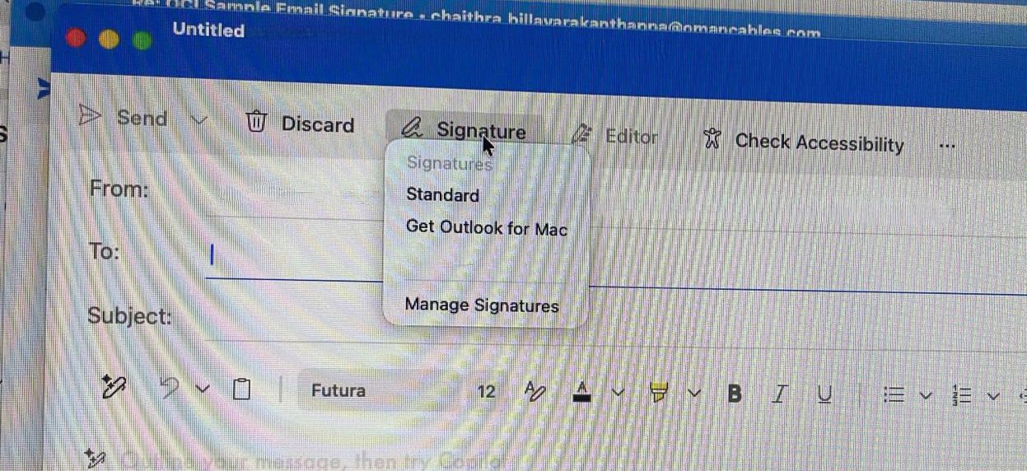
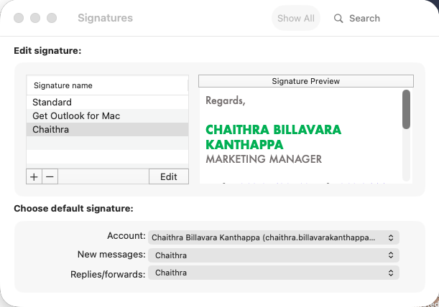
Using Outlook
Step 1:
Step 2:
Open a new email on Outlook.
Select Signature from the top, then Manage Signatures
A window prompt will show.
2
Click the + button to add a new Email Signature. Give it a name.
Paste the text in the Signature preview window.
OCI Signature
Full Name
Job Description
M.+968 1234 5678, T.+968 1234 5678
1
omancables.com

Slide 6

Using Outlook
Step 3:
And you’re done!
Your new email signature is ready to use.
Full Name
Job Description
M.+968 1234 5678, T.+968 1234 5678
Confidentiality Notice: This email and any attachments are intended solely for the addressee and may contain privileged information belonging to Oman Cables Industry (SAOG). Unauthorized disclosure, forwarding, or use is strictly prohibited.
omancables.com

Slide 7





omancables.com

